Slide 1
Fundsbook
Team 16
Luis Diaz, Temuulen Ganbold, Julio Ojalvo

Slide 2
Project Recap
Social media platform for budgeting and money management
Use social media to attract young people
Teach them how to save their money
Hope to bring on financial experts to help users get started

Slide 3
System Overview
Our system will be comprised of a central database and the surrounding components that access that information
Database will store user information, budget plans with their tags, and profile information
Components of the system such as the log-in function and the search function will access the database in order to complete their tasks and update the information in it when necessary

Slide 4
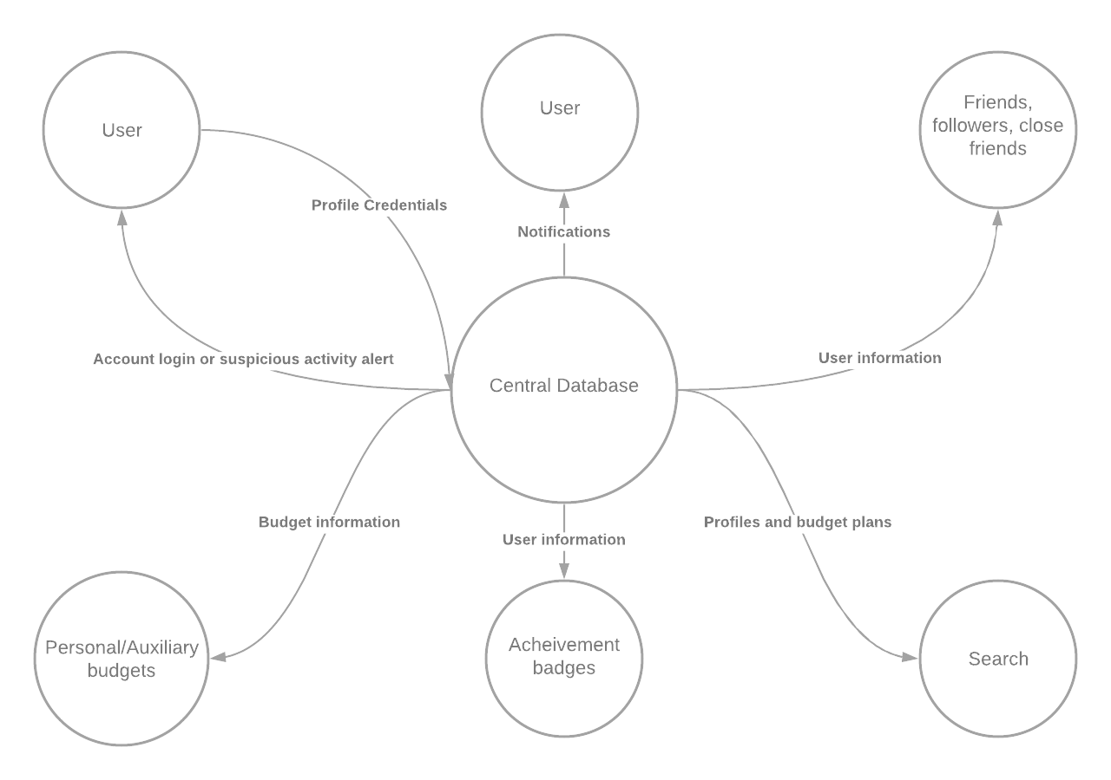
System Diagram

Slide 5
System Actors
Primary Actors
Users - Calls on the system to deliver a service (Log in, search, etc.)
Devices - Initiates a use case and requires the system to achieve its goal
Any android mobile devices
Any IOS mobile devices
Secondary Actors
Central database - Provides data for the other use cases to complete their functions
Client and server - Proves a way to share data among users for use cases to work

Slide 6
Design Patterns
Creational Design Pattern
Prototype: Allows us to create a prototypical budget that is cloned to produce more detailed user budgets
Structural Design Patterns
Facade: Allows us to simply display information on a user’s profile
Adapter: Allows all of our components to communicate with each other
Decorator: Allows us to add functionality to existing components
Behavioral Design Pattern
Command: Allows us to encapsulate command requests as objects to avoid data retrieval conflicts

Slide 7
Framework
SPRING: Java + Hibernate + MySQL/PostgreSQL
Allows us to create and query information from our central database
Provides more security to our application with industry-standard security schemes

Slide 8
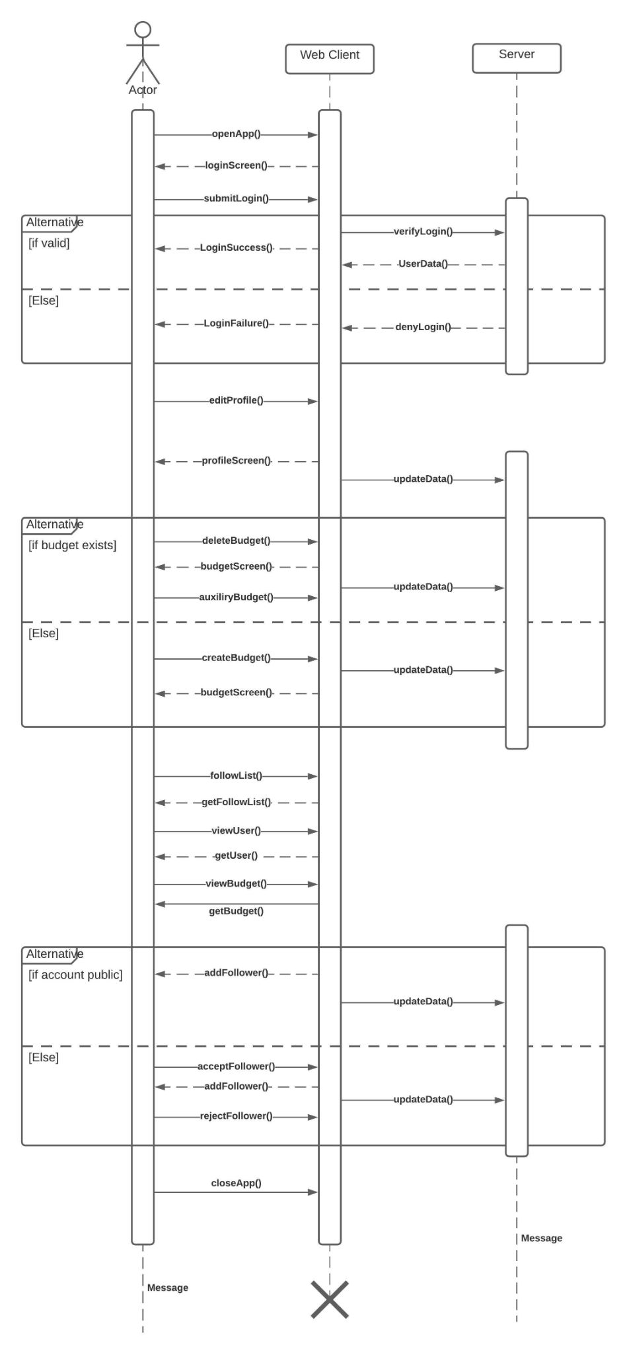
Sequence Diagram

Slide 9
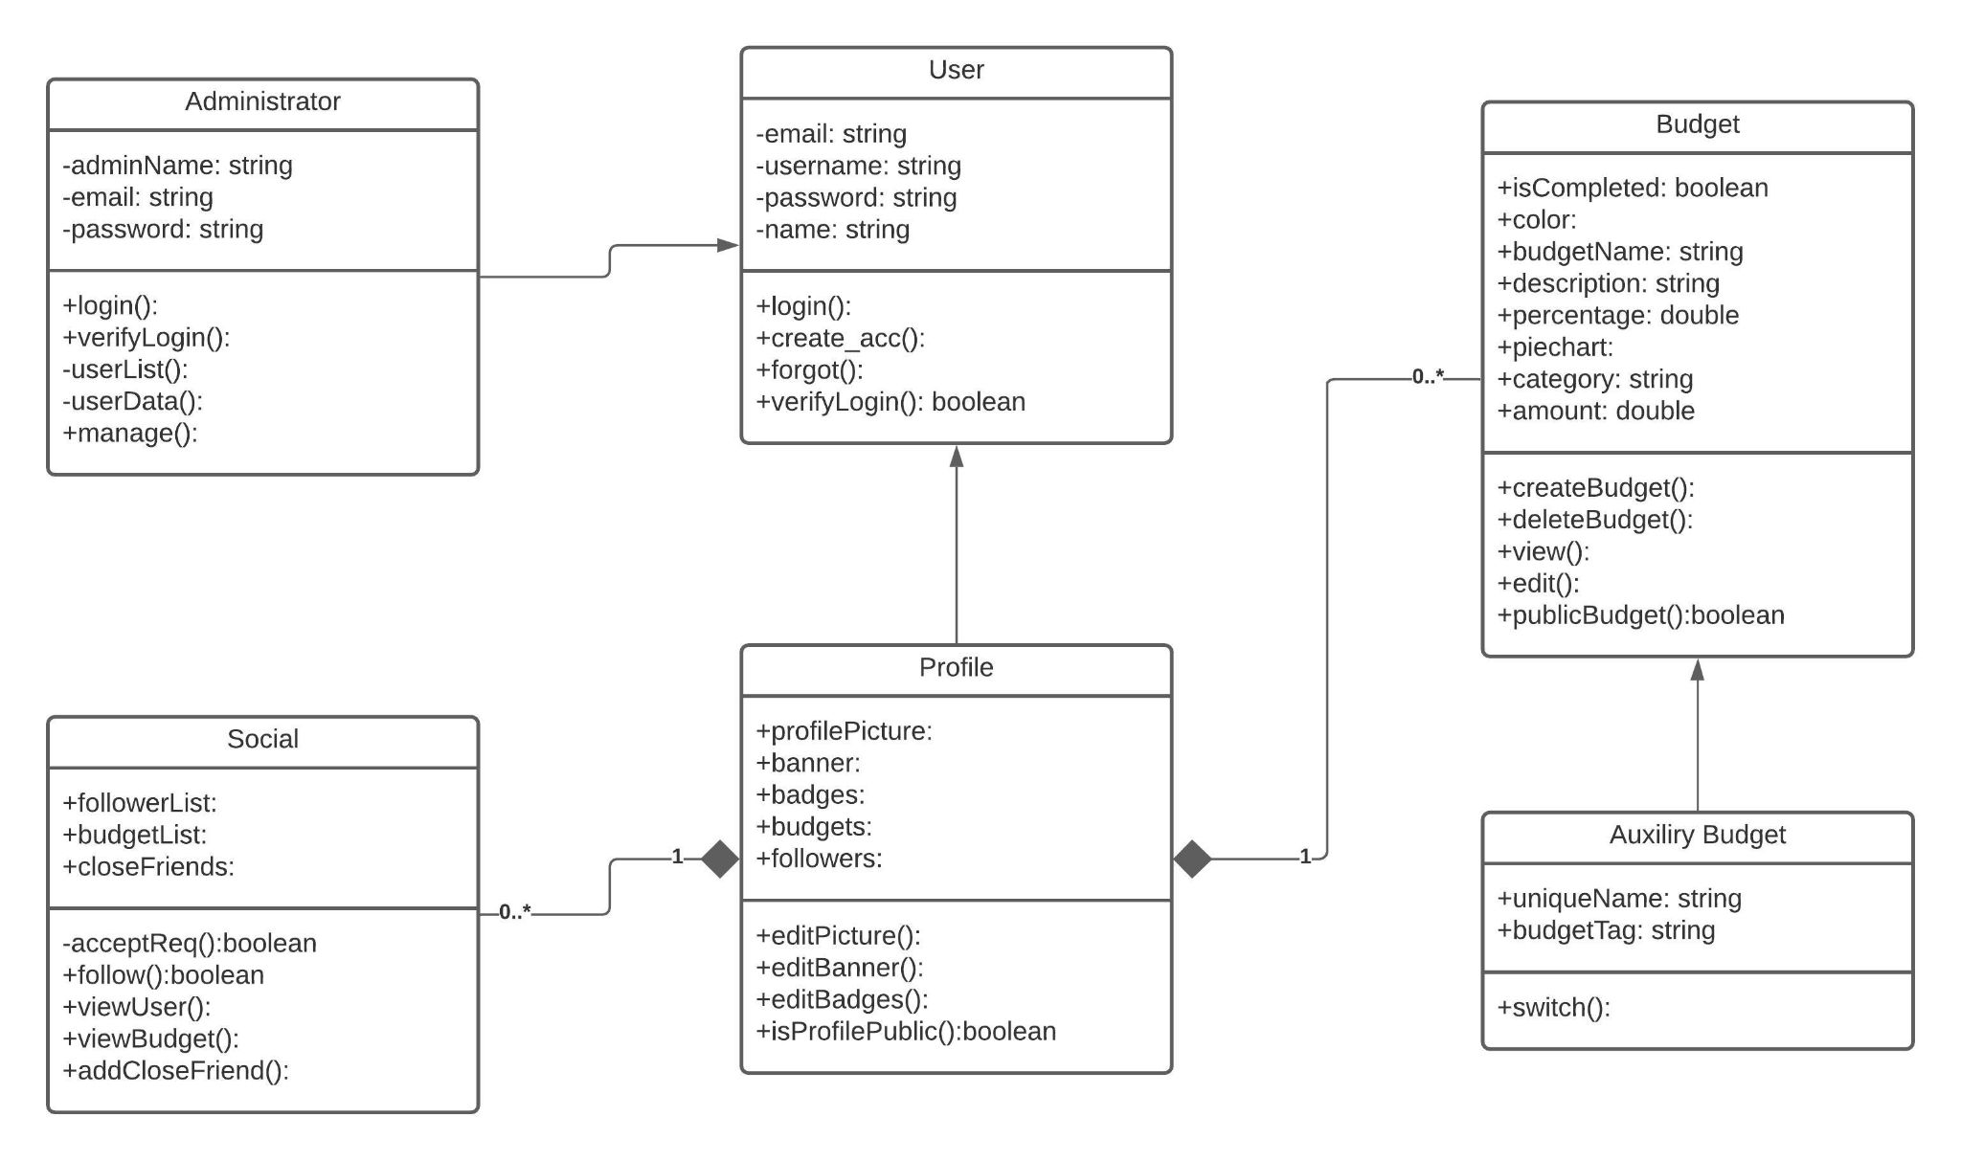
Class Diagram

Slide 10
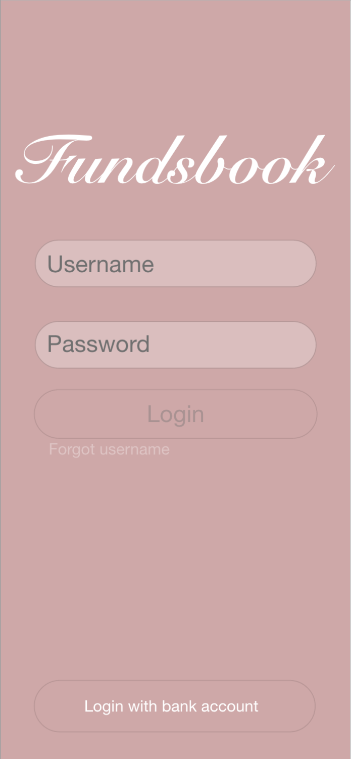
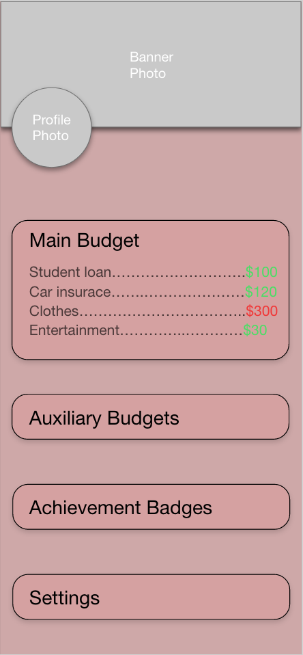
Project Mock-up

Slide 11
GitHub Link
https://github.com/AlonsoL99/CSC431

